Slide 1
NLP - Section 6
Word Vectors

Slide 2
Embeddings
An embedding is a numerical representation of a word.
The representation of the word doesn’t account for the context.
Words that occur in the same context have close numerical representation
Two types:
A. Word Embeddings: no context
B. Contextual Embeddings: with context

Slide 3
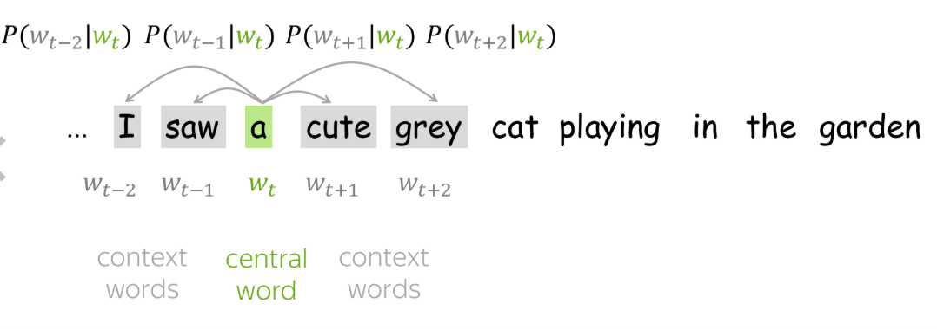
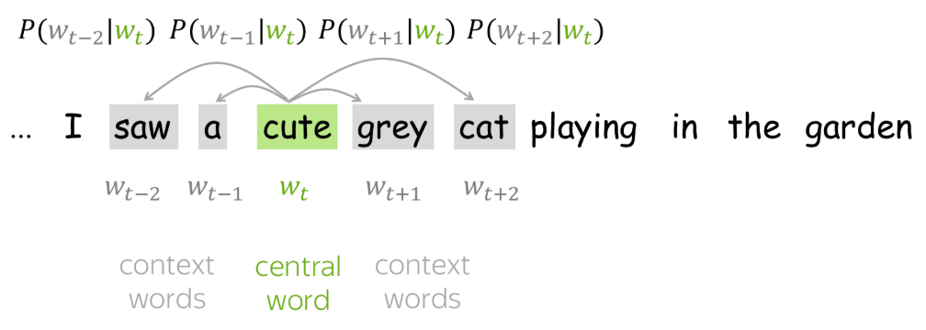
Word2Vec
There are various techniques for word embeddings, one of which is Word2Vec
Word2Vec is based on continuous skip-gram architecture where it predicts the context words given the current words.

Slide 4
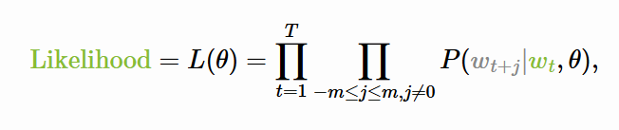
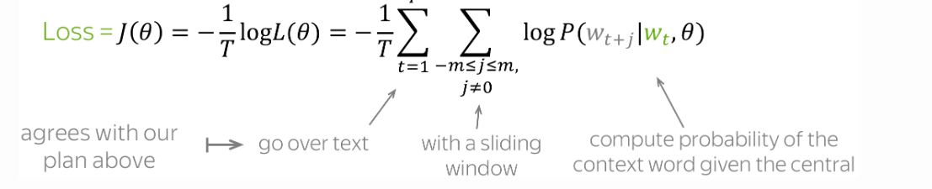
Word2Vec Cont.

Slide 5
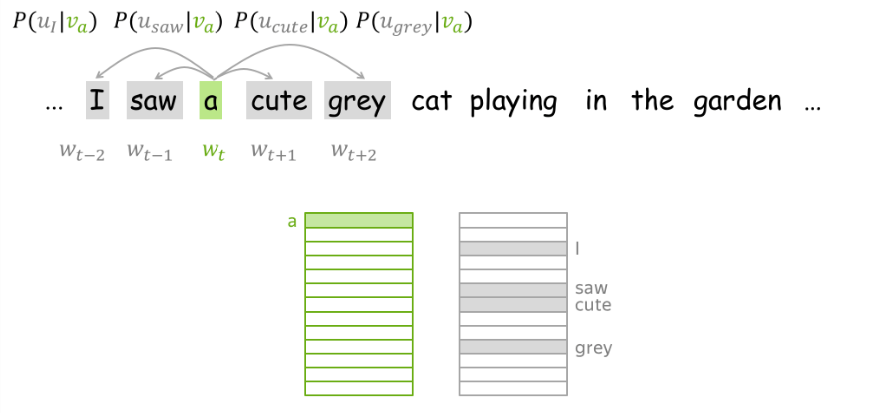
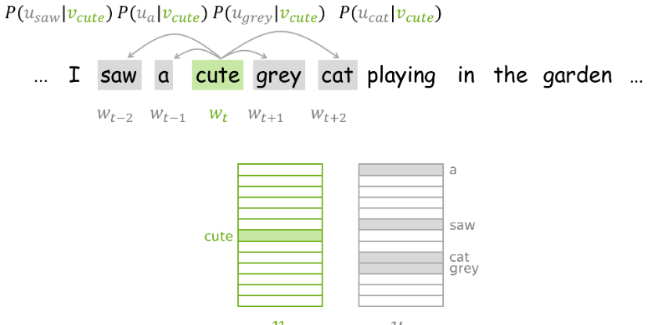
Skip Gram
Source: https://lena-voita.github.io/nlp_course/word_embeddings.html

Slide 6
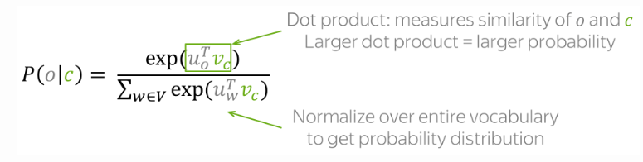
Word2Vec Calculations how to calculate this
We use softmax function

Slide 7
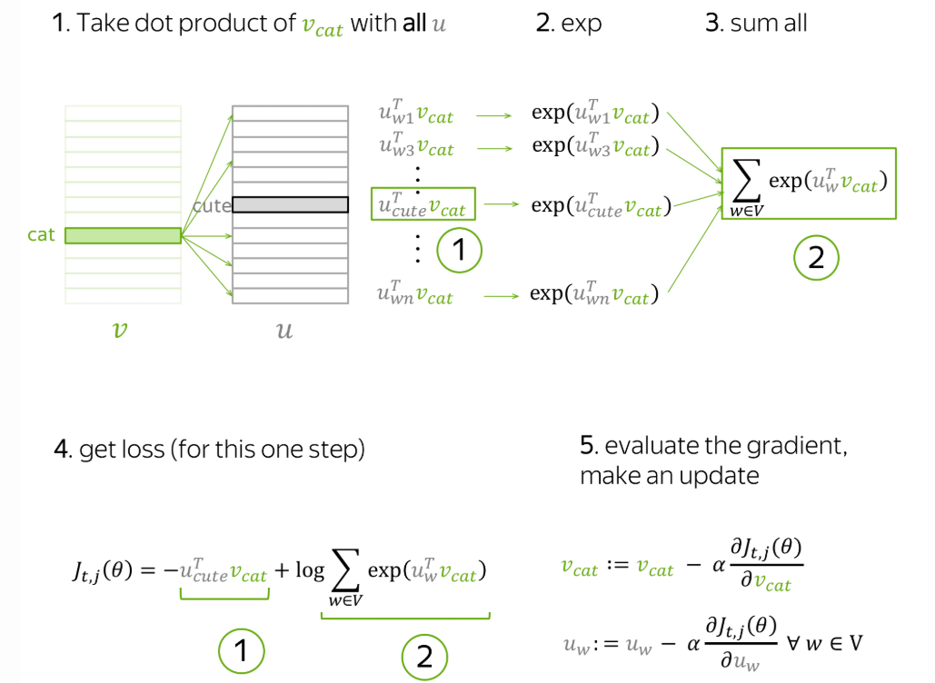
Gradient Descent Training

Slide 8
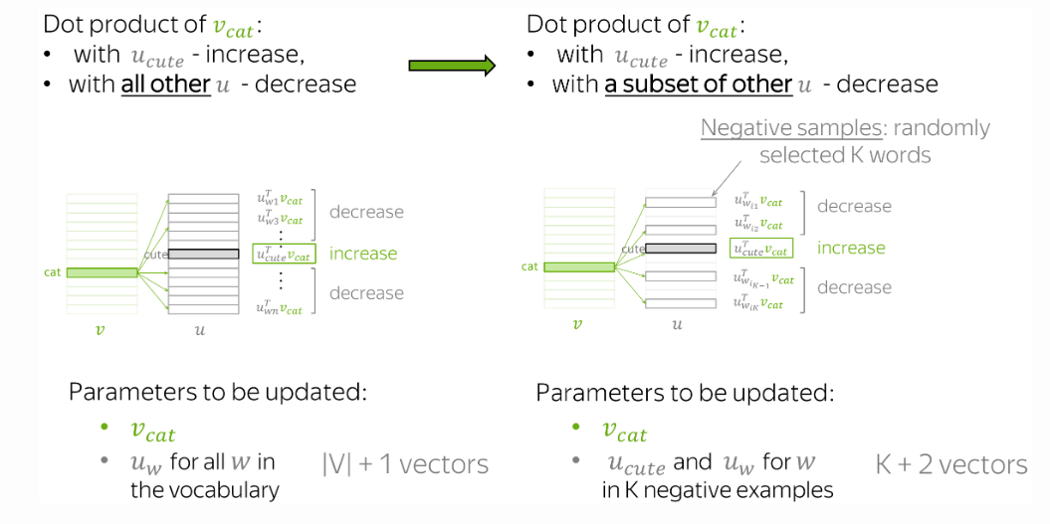
Negative Sampling

Slide 9
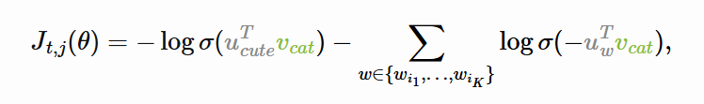
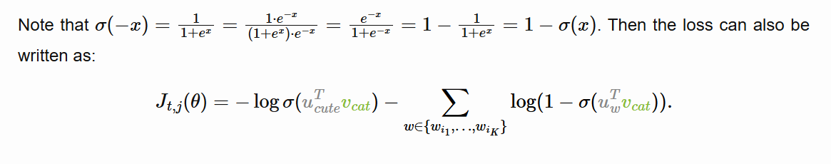
Negative Sampling Cont.

Slide 10
Training
We initialize the matrices for the embeddings and the context.
Both have the same (vocab_size, embedding_size)
We create a dataset with 0 and 1, 0 is not in context and 1 is in context of the center word
We then train the model using gradient descent to predict if the word is in context or not of the center, this spans the entire corpus.

Slide 11
Code
Word2Vec Implementation from Scratch

